Slide 1
Comparative Sentiment Analysis
NEWS COVERAGE VS PUBLIC OPINION
Presented by:
Krit Gupta
Piyush Bhatt

Slide 2


Aim and Motivation
We wish to compare the similarities and differences between the news covered by mainstream media and its relation to the general concerns of the public.
This analysis can be used by concerned government bodies to take up real issues

Slide 3
Methodology
Topic Modelling
What are the “topics” people talking about?
What are the “topics” news houses taking up?
Opinion Mining/Sentiment Analysis
What are their (People or Media) sentiments/opinions about the topics they are taking?
Where will the data come from?
Scraping Facebook pages of news houses
Using Twitter API to get public data

Slide 4
What do we want!
Concerns during given time frame
Sentiment about a particular topic over a given time frame
Change in the sentiment about a topic over time period
Influence of news on public or vice versa (We are not biased!)

Slide 5
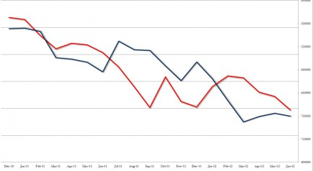
Visualization:

Slide 6
BYE BYE!
QUESTIONS?

